Slide 1
Implementing DHCP
Huynh Nguyen Chinh
Notes:
1

Slide 2
DHCP overview
All network clients need to have unique IP addresses assigned to their network interfaces
Manually assigning addresses and tracking the information can be arduous, even in small networks. Dynamic Host Configuration Protocol (DHCP) plays an important role in a typical network infrastructure.

Slide 3
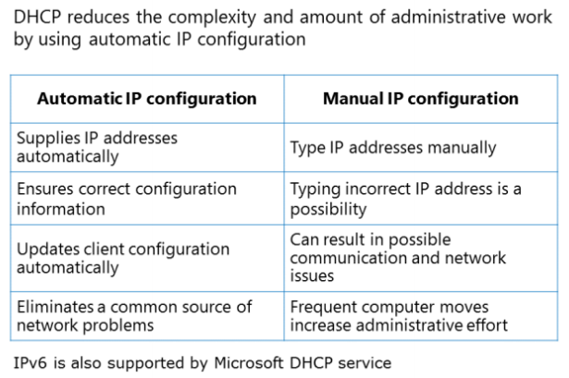
DHCP overview

Slide 4
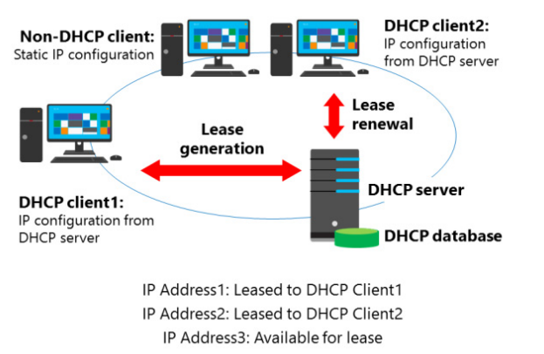
How DHCP allocates address

Slide 5
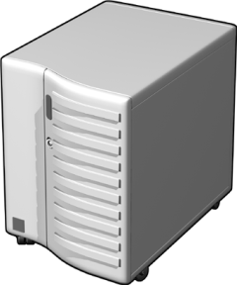


How DHCP lease generation works
Hoạt động của DHCP
DHCP Server2
DHCP Server2
DHCP Server1
DHCP Server1
DHCP Client
DHCP Client
DHCP client broadcasts a DHCPDISCOVER packet
1
DHCP client broadcasts a DHCPDISCOVER packet
1
DHCP servers broadcast a DHCPOFFER packet
2
DHCP servers broadcast a DHCPOFFER packet
2
DHCP client broadcasts a DHCPREQUEST packet
3
DHCP client broadcasts a DHCPREQUEST packet
3
DHCP Server1 broadcasts a DHCPACK packet
4
DHCP Server1 broadcasts a DHCPACK packet
4

Slide 6



How the DHCP Lease Renewal Process Works
DHCP Server2
DHCP Server2
DHCP Client
DHCP Client
DHCP Server1
DHCP Server1
50% of lease duration has expired
50% of lease duration has expired
87.5% of lease duration has expired
100% of lease duration has expired
If the client fails to renew its lease, after 50% of the lease duration has expired, then the DHCP lease renewal process will begin again after 87.5% of the lease duration has expired
If the client fails to renew it’s lease, after 87.5% of the lease has expired, then the DHCP lease generation process starts over again with a DHCP client broadcasting a DHCPDISCOVER
DHCP Client sends a DHCPREQUEST packet
1
DHCP client sends a DHCPREQUEST packet
1
DHCP Server1 sends a DHCPACK packet
2
DHCP Server1 sends a DHCPACK packet
2

Slide 7







How a DHCP Server Service Is Authorized
If DHCP Server1 finds its IP address on the list, the service starts and supports DHCP clients
DHCP Server1 checks with the domain controller to obtain a list of authorized DHCP servers
Domain
Controller
DHCP Server1
Authorized
Active
Directory
Services DHCP requests
DHCP Server2
DHCP Client
Unauthorized
Does not service DHCP requests
DHCP Server2 checks with the
domain controller to obtain a list of
authorized DHCP servers
If DHCP Server2 does not find its IP address on the list, the service does not start and support DHCP clients
DHCP client receives IP address
from authorized DHCP Server1
DHCP authorization is the process of registering the DHCP Server service in the Active Directory domain to support DHCP clients

Slide 8
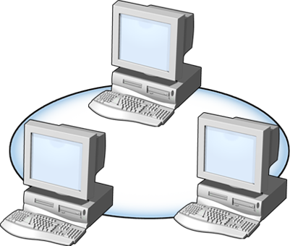

What Are DHCP Scopes?
A scope is a range of IP addresses that are available to be leased
DHCP Server
LAN A
LAN B
Scope A
Scope B
Scope Properties
Network ID
Subnet mask
Lease duration
Network IP address range
Scope name
Exclusion range

Slide 9
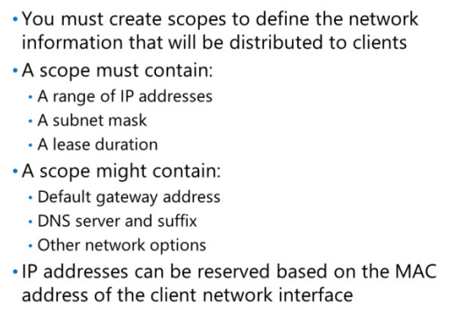
What Are DHCP Scopes?

Slide 10
Demonstration: Configuring a DHCP Scope
Your instructor will demonstrate how to:
Configure a DHCP scope
Activate a DHCP scope

Slide 11

What Are Superscopes and Multicast Scopes?
DHCP Server
LAN A
LAN A
Scope A and Scope B
DHCP Server
LAN A
LAN B
Scope A
Scope B

Slide 12
Lesson: Configuring DHCP Reservations and Options
What Is a DHCP Reservation?
What Are DHCP Options?

Slide 13


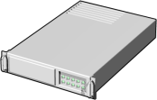
What Is a DHCP Reservation?
A reservation is a specific IP address, within a scope, that is permanently reserved for lease to a specific DHCP client
Workstation 1
File and Print Server
Subnet A
Subnet B
DHCP Server
Workstation 2
IP Address1: Leased to Workstation 1
IP Address2: Leased to Workstation 2
IP Address3: Reserved for File and Print Server

Slide 14


What Is a DHCP Relay Agent?
A DHCP relay agent is a computer or router that listens for DHCP/BOOTP broadcasts from DHCP clients and then relays those messages
DHCP Relay Agent
DHCP Server
Unicast
Broadcast
Broadcast
Subnet A
Subnet B
Routers
(Non–RFC 1542 Compliant)
Client
Client
Client
Client

Slide 15

How a DHCP Relay Agent Works
DHCP Relay Agent
DHCP Relay Agent
DHCP Server
DHCP Server
Client2
Client2
Router
Non-RFC 1542 Compliant
Client1
Router
(Non–RFC 1542 Compliant)
Client3
Client3
Client1
1
Client1 broadcasts a DHCPDISCOVER packet
2
Relay agent forwards the DHCPDISCOVER message to the DHCP server
3
Server sends a DHCPOFFER message to the DHCP relay agent
4
Relay agent broadcasts the DHCPOFFER packet
5
Client1 broadcasts a DHCPREQUEST packet
6
Relay agent forwards the DHCPREQUEST message to the DHCP server
7
Server sends a DHCPACK message to the DHCP relay agent
8
Relay agent broadcasts the DHCPACK packet

Slide 16
????

